Slide 1
Tweet wars
The tweets of Hillary Clinton and Donald trump
By JOHN HALLORAN

Slide 2
Why these two twitter accounts
Both provide information about similar events. Tweets might be similar in the regard that they discuss similar events but differ in word choices
Their tweets reach a large audience based on the number of likes and retweets they have. Information like that can help determine which words might resonate strongly with an audience.
Word choices might also give us a glimpse into their writing style. They might reflect a specific grade level based on the words they use.

Slide 3
Questions
What words are most commonly used in their tweets? How do they differ?
What can we understand about their vocabulary grade level?
What words correlate to their most reactions (favorites and retweets)?

Slide 4
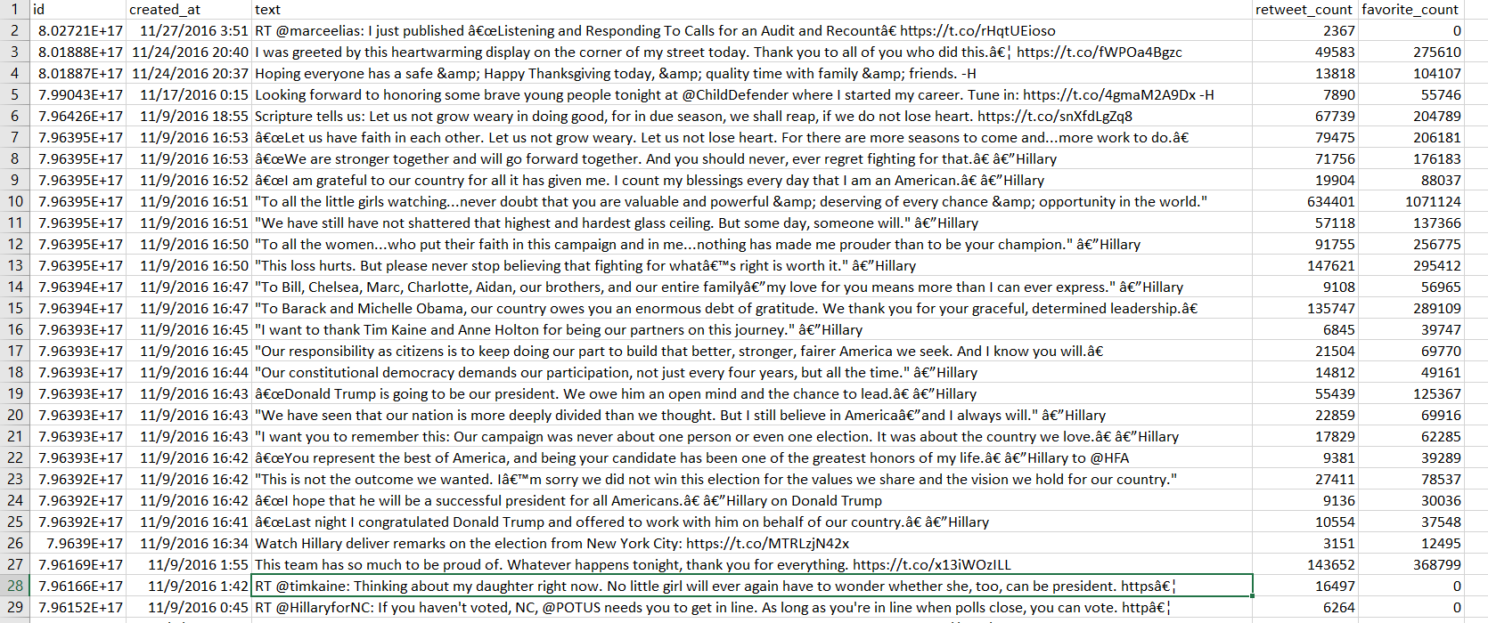
Snapshot of Hillary Clinton’s tweet

Slide 5
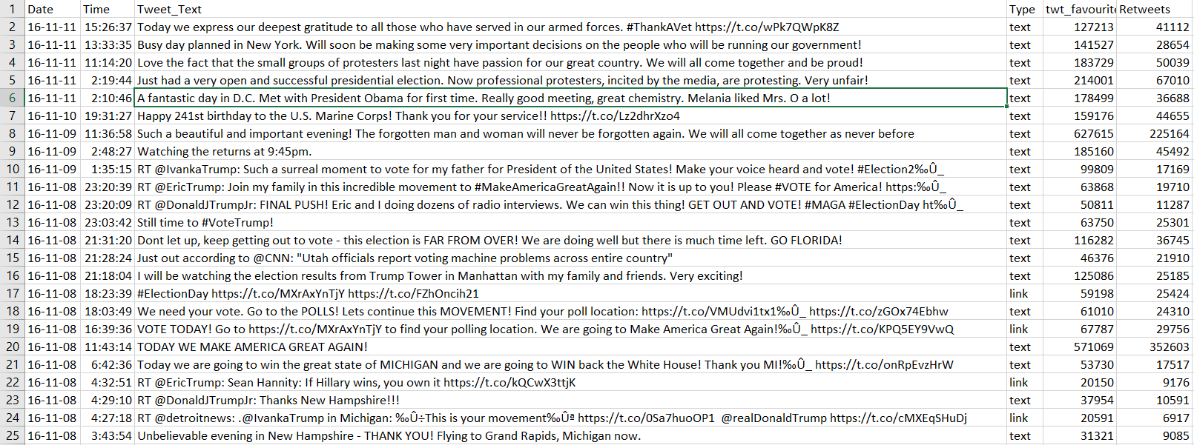
Snapshot of Donald Trump’s tweets

Slide 6
Sources
User: andrewginns https://github.com/andrewginns/idp-twitter/blob/master/HillaryClinton_tweets.csv
Alidina, Abbas, Donald Trump’s 11 Best Tweets (and 7,000 Losers), November 14, 2016, Accessed February 14, 2017 https://www.crowdbabble.com/blog/the-11-best-tweets-of-all-time-by-donald-trump/

